Slide 1
How to Prepare a Cash Flow Statement
Personal Finances, Your Springboard to Business Success

Slide 2
Welcome to Money 101 EDUCATION
Money 101 Education is a program to help individuals gain financial literacy.
There are now five segments – each is five classes.
Foundation
Investments
Taxation
Real Estate
Money and Life Cycles – from Birth to Death

Slide 3
This PowerPoint focuses on how to prepare a CASH FLOW STATEMENT
The Cash Flow Statement is one of the two financial reports you need to manage your finances. It is often called a budget, but as that word has negative conotations, in Money 101 Education, we call it a CASH FLOW STATEMENT.
The other critical form is a Personal Financial Statement.
Both forms are covered in the Foundation Segment.
If you enjoy the experience, consider enrolling in a live class from Money 101 Education – see calendar here: https://money101education.com/calendar/

Slide 4
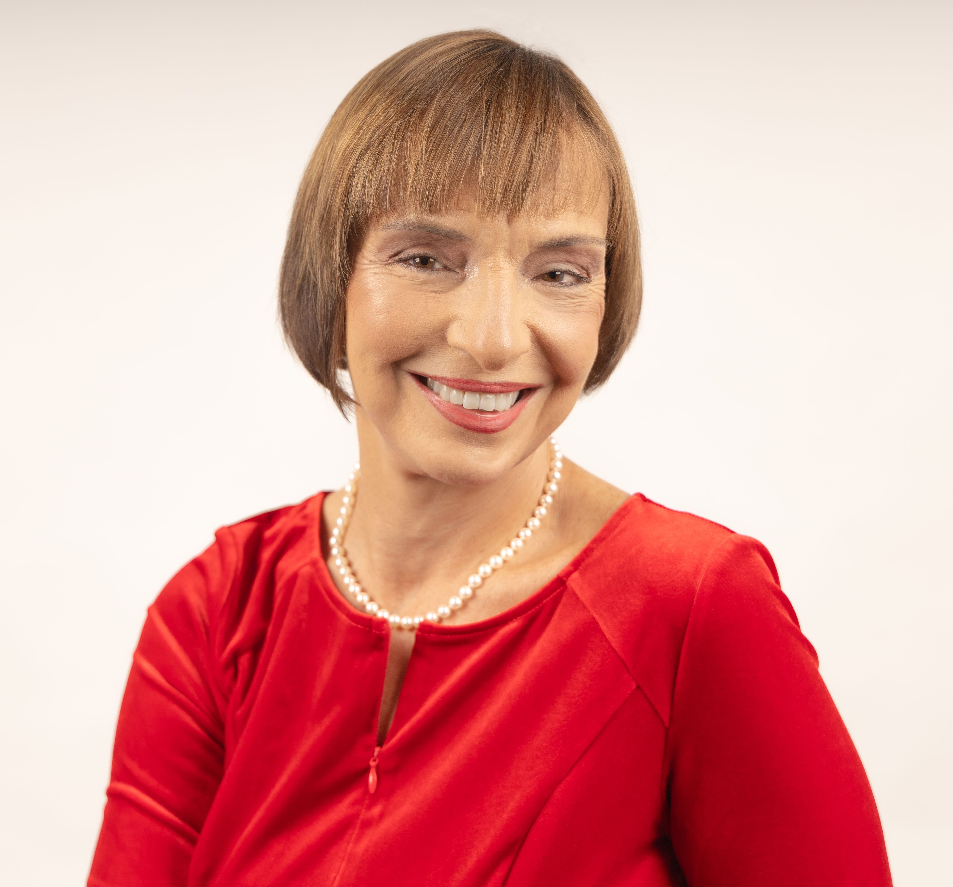
A bit about DIANE DREY – the Speaker
32 years President 5 gallon bottled water business
5 years running a travel program to China –
Since 2008 certified Score mentor - over 1,000 clients, expertise in Finance & Marketing
2014-2016 - NYC Score Chapter Chair
2017 - Founded Score NYC Advisory Board service for companies with management teams.
2019 - Creator of Money 101 Education – a financial literacy program for women – practical advice in a small group learning enviornment

Slide 5
Financial Freedom
Comes from knowledge:
Assess where you are today.
Set a goal of where you want to be tomorrow (or at retirement)
Map a path to get there.
The measuring stick is NET WORTH
and learning how it can create an income stream.

Slide 6
The Obstacles We Face
The fear factor “writing it down makes it real.”
The thought “you are not where you should be.”
The belief “everyone else is better off.”
The mindset “I have no power to make changes.”
The inaction “I will deal with it tomorrow.”
Acknowledge the above – and then move on
you can’t begin to improve until you face reality.

Slide 7
QUOTE from article by James Clear
Unfortunately, we often avoid measuring because we are fearful of what the numbers will tell us about ourselves. The trick is to realize that measuring is not a judgment about who you are, it's just feedback on where you are.
Measure to discover, to find out, to understand. Measure to get to know yourself better. Measure to see if you're actually spending time on the things that are important to you. Measure because it will help you focus on the things that matter and ignore the things that don’t.

Slide 8
Workshop goals
PREPARE – two key documents
SESSION ONE - CASH FLOW STATEMENT
records cash in and cash out over a period of time (year)
SESSION TWO - Personal Financial Statement
lists assets and liabilities to calculate Net worth at a point in time
UNDERSTAND how the two interconnect

Slide 9
Step 1 – First time prepare an ESTIMATED budget
TIP - Adjust your mindset to think on an annual basis (not monthly) –
GOAL - Get a helicopter view first.
TIP- A Budget is best prepared first looking at past history, and then projecting forward
TIP – A BUDGET MUST be in writing – or it does not count!
ACTION – List the areas/categories where you receive or spend cash during a year – list no more than 25 Categories
ACTION - Prepare a fast – back-of-the-napkin estimate of cash in and cash out for those categories.

Slide 10
Review Categories of Cash In and Cash Out
TIP – We will use handout 3.01 The LONG BUDGET FORM during this class – it lists OVER 90 categories of CASH Sources and Uses
The form is based on a “Case Information Statement” used in courts to determine alimony and child support. Having 90 categories is not practical on an ongoing basis, but it will be helpful initially to jog your memory of items you may have forgotten
Review - Handout 3.01 Annual Budget Form with Categories

Slide 11
Step 2 - Be Practical Consolidate your list to 25 or less categories
1 | SOURCE | W-2 earnings (gross before deductions)
2 | SOURCE | Interest and Dividends on Investments excluding retirement accounts
3 | SOURCE | Retirement Savings Distributions (401K, Roth, IRA)
4 | SOURCE | Rental Property income
5 | SOURCE | Business Related Income or Rental Property Income
6 | SOURCE | Misc. & One-time events (sale of assets, insurance proceeds, gifts, loans from family friends, inheritance)
7 | USE | Housing (rent, mortgage, real estate taxes, utilities, maintenance, housekeeping, and housing insurance)
8 | USE | Food at home + household/cleaning products,
9 | USE | Transportation (public transportation, car payments, car insurance, tolls, maintenance)
10 | USE | Discretionary - (clothing, entertainment, cell phone, sports, gifts, vacations, restaurants)
11 | USE | Child/Dependent expenses (childcare, education, clothing, sports programs)
12 | USE | Medical related- insurance premiums, drugs, doctor/hospital copay, deductibles
13 | USE | Insurance -Life, Umbrella, Disability Insurance (exclude housing/medical)
14 | USE | Taxes (paid through withholding, estimated, or paid at time of filing)
15 | USE | Debt Repayment (items purchase in prior periods now being paid off)
16 | USE | Savings (pre-retirement and retirement)
17 | USE | One-time expenses
18 | USE | Business Related Expenses (if you mingle your business and personal budget)

Slide 12
Step 2 – Gather ACTUAL data
ACTION – Gather
W-2 from prior year
Tax Return from prior year
DOWNLOAD bank transactions from prior year (best to put in excel)
DOWNLOAD credit card transactions (best to put in excel)
ACTION - Consolidate bank & credit card transactions into one sheet
Add the “Category code” to each transaction
Sort & Subtotal by Category Code
TIP - SIMPLIFY – one bank, one credit card

Slide 13
SAMPLE download of bank and credit card transactions

Slide 14
SAMPLE– Sort by type & subtotal

Slide 15
Step 3 – ENTER category subtotals on form 3.01 (simplified)

Slide 16
Once you have the prior year’s transactions
Determine were cash positive or cash negative in the prior year.
Review what will or can be different in the coming year. –
Focus on big ticket items.
Focus on Income
Prepare a Cash Flow Statement for the coming year
Check in at least annually to see if you are on track

Slide 17
EXERCISE - Prepare Maria’s Cash Flow Statement
Divide into breakout groups (approx. 4- 5 people per group)
One person with Word and Excel to SHARE their screen with group
SCROLL through exercise 3.11a. Which has 35 questions – Each person to answer 5 questions, then rotate to the next person.
The person sharing their screen should Enter the answers ON WORD DOCUMENT
in Column A – is this budget item? - yes or no
in Column B – if a budget item the amount of cash in or cash out
Then when done:
ENTER on excel form 3.01a next to the proper category the amount
ADD up the cash in and cash out and CALCULATE
Is Maria Cash positive or negative for the year, and by how much?

Slide 18
Cash Flow Statments need to work for you – use meaningful categories
Calculate the PERCENT each item contributes to overall cash in or cash our
Focus on larger items
MOST IMPORTANT – don’t think of “cutting down on expense” – think of ways you can increase your income
Review - 3.11c and 3.11d
Maria’s Annual Budget consolidated showing % of income and expenses

Slide 19
Monthly Budget
You can refine your annual cash flow statement to a monthly – but do the annual first.
When preparing a monthly budget key areas to adjust/watch:
Payroll periods
Income and Expenses which are not routine
Tax Liabilities - estimating what is due
Review -Handout
3.02 Monthly form

Slide 20
What is your next step?
Write down up to 3 actions you will take based on today’s seminar
Set a deadline for when you will accomplish each
Post it on your refrigerator/desk

Slide 21
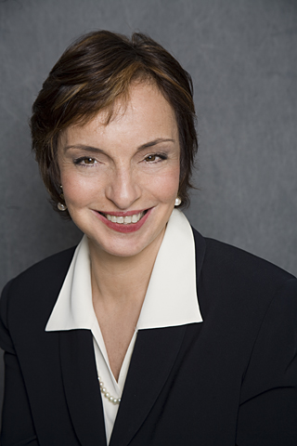
FREE Personal ZOOM Mentoring Sessions…
I am here to help.
Get the link to book an appointment
https://money101education.com/home/private-appointments/

